Slide 1


SANJIVANI RURAL EDUCATION SOCIETY'S
SANJIVANI COLLEGE OF ENGINEERING KOPARGOAN-423601
(An Autonomous Institute, Affiliated to Savitribai Phule Pune University, Pune)
2022-2023
Department OF Computer Technology
Sub: Database Management System
Self Learning Activity
Topic : PostgreySQL
Class: SY Div: A
Dr. D. B. Kshirsagar Prof.Saiprasad Sir
(H.O.D) (Guide)

Slide 2

67-Swapnil Jadhav 68-Yash Jondhale 142-Ishwari Kape 151-Sanket Tambe 153-Aditi Bairagi

Slide 3

Content
Introduction
Queries
Data Types
Conclusion
References
Schemas and privileges
Index
Defining tables

Slide 4

Introduction
PostgreSQL is one of the most advanced general-purpose object-relational database management system and is open-source. Being an open-source software, its source code is available under PostgreSQL license, a liberal open source license. Anyone with the right skills is free to use, modify, and distribute PostgreSQL in any form. As it is highly stable, very low effort is required to maintain this DBMS. that provides a high level of robustness, scalability, and reliability. It was first released in 1989 as a research project and has since then evolved into one of the most advanced and popular open-source databases in the world. PostgreSQL offers a wide range of features that make it an ideal choice for large and complex applications. Overall, PostgreSQL is a powerful, flexible, and reliable database management system that can be used for a wide range of applications, from small-scale projects to large-scale enterprise applications.

Slide 5
Queries
Simple query
Retrieving a portion of the rows
Sorting queries
Table and column aliases
Limit and offset options
Combing queries
Aggregate funcions

Slide 6
Simple query – select
Retrieve one column name
Retrieve multiple column names
Avoid the duplicate from output – DISTINCT
Syntax : select DISTINCT salary from table_name;
Retrieving a portion of the rows
Select – where
Syntax : select * from table_name where[condition];
Example: select * from emp where salary > = 6000;
Find record in between two numbers(range) by
using AND
Ex: select name from emp where salary >4500
and salary <=5000;
Sorting queries
To explicitly sort the rows we use order by clause.
Syntax : select * from table_name order by column_name;
By default it displays in ascending order.
To make descending order
Syntax : select * from emp order by column_name desc;
Ex : select * from emp order by salary desc null last;
Table and column Aliases
Aliases means temporary alternative name to column or table.
Syntax : select column_name AS new_col_name from table_name;

Slide 7
Limit and offset option
LIMIT : will retrieve only the number of records specified after the LIMIT keyword.
Syntax : select * from table_name limit 3;
Offset : used to skip some records before returning the result set of a query
Syntax : select * from table_name offset 4;
Ex : select * from emp limit 3 offset 4;
Combining queries
Union(combing two tables avoiding duplicates)
Union all(All records with duplicates)
Intersect ( Common records)
Aggregate Functions:
Sum
Avg
Max
Min
Ex : select sum(sal) As total from emp;

Slide 8
Data types
Numeric Types
Character Types
Date/Time Types:
Boolean Types:
Geometric Types:
Arrays:

Slide 9
We define the data type of a column when we create the column
Numeric Types:
Integer
Integer is numbers, in another word numbers that do not have fractional component We can define scale and precision for numeric: NUMERIC(S,P) .For example, NUMERIC(15,3) .It accepts NaN special value
Floating point numbers
These data types accept some special non-numeric values including: infinity, -infinity and NaN.
Serials
It is used to create unique identifier columns
When creating a column with this data type, the system will implicitly create a sequence that is used to insert incremented values in this Column
Data types, in general, are used to define the type of the values in table’s columns
2. Character Types:
Char or Character
CHAR is used for fixed-length character strings, which means that the number of characters
Character Varying or Varchar
VARCHAR is used for variable-length character strings, which means that the number of characters specified in the column definition is the maximum number of characters that can be stored
Text
Text stores strings of any length

Slide 10
3 . Date/Time Types:
Timestamp without time zone
Timestamp with time zone
Date Time without time zone
Interval
4. Boolean Types:
In the output: the true value will be represented with t, while false will be represented with f. Null will appear as empty
True
False
Unknown
Data types, in general, are used to define the type of the values in table’s columns
5. Geometric Types:
They are used to represent two- dimensional objects They include: point, line, Iseg, box, path, polygon and circle
6. Arrays:
The PostgreSQL Array data type is used to store the array values for a specified column.

Slide 11
Schemas and privileges
Creating a Schema
Drop schema
Grant privilege on table
Revoke privilege on table
Grant privilege on colume

Slide 12
There are several reasons why one might want to use schemas:
• To allow many users to use one database without interfering with each other.
• To organize database objects into logical groups to make them more manageable. • Third-party applications can be put into separate schemas so they do not collide with the names of other objects.
1. Creating a Schema
Syntax : CREATE SCHEMA myschema;
To create or access objects in a schema, write a qualified name consisting of the schema name and table name separated by a dot:
Schema.table
Example – mydb-# Create table staff_schema ;
mydb-# Create table staff_schema.employee (ID integer primary key , name text )
2. Drop schema
To drop a schema if it’s empty (all objects in it have been dropped), use:
Mydb-# drop schema staff_schema;

Slide 13
3. Grant privilege on table
1
Grant select,update,insert,delete,truncate on table employee to user1 ;
2
4. Revoke privilege on table
3
Revoke Grant select,update,insert,delete,truncate on table employee from user1;
4

Slide 14
Index
Index uses and benefits
Index Types
Create and Drop an Index:
multi-column index:
Indexes on Expressions:
Unique Index and Partial Index
Create and Drop Index Using pgAdmin

Slide 15
Index uses and types
Index:​
They are used to enhance database performance​
They are indexes very similar to book​
They are built on tables' columns​
PostgreSQL builds an implicit index on primary key and unique key columns​
After creating the index, you do not have to update it.​. It will be updated automatically
You do not have to direct the database server to use an index. If an index exists, it will be used if PostgreSQL thinks it is more efficient than scanning the table row by row
Indexes Disadvantages:​
Some indexes take lots of space​
They might slow performance if they appropriately are database not built​
When should we index a column?​
When we use this column to limit the results of our queries​
When the column is joining two table, and we usually do many joined queries using this column​

Slide 16
Index Type:​
Index types in PostgreSQL:​
B-Tree: stands for balanced tree​
we use B-Tree index for queries that include comparison operators:​
Greater than, less than, greater than or equal, less than or equal, equal, not equal, between and, is null and is not null.​
Index types in PostgreSQL:​
Hash index: can only handle simple eq​
Index types in PostgreSQL:​
Generalized search Tree (GIST): are used for more complicated datatypes and for operations beyond equality and range comparison​
Mainly used with the geometric datatypes​
Generalized Inverted Indexes (GIN): are useful when an index must map many values to one row​
Mainly used with arrays​

Slide 17
Operations on index
Create and Drop an Index:
Create and Drop an Index
Syntax:
CREATE INDEX indexname
ON tablename (columnname1, columnname2, …);
Create a unique index on a table:
DROP Index
The DROP INDEX statement could be used to remove an index from any table.
Syntax:
DROP INDEX tablename.indexname;
multi-column index:
Syntax:
CREATE INDEX [index name]
ON [Table name]([column1, column2, column3,...]);
An index can be defined on more than one column of a table. For example, if you have a table of this form:
CREATE TABLE test2 ( major int, minor int, name varchar);

Slide 18
Indexes on Expressions:
For creating an index on expression, we have the following illustration:
CREATE INDEX index_name
ON table_name (expression);
Unique Index and Partial Index:
UNIQUE Index
CREATE UNIQUE INDEX index_name
ON table_name(column_name, [...]);
Partial Index:
Syntax:SELECT * FROM table_nameWHERE column_name = constant_value;
Create and Drop Index Using pgAdmin:
Drop Index
DROP INDEX [ CONCURRENTLY]
[ IF EXISTS ] index_name
[ CASCADE | RESTRICT ];
Create Indexes:
The syntax of creating an Indexes command is as follows:
CREATE INDEX index_name ON table_name [USING method]
(
column_name [ASC | DESC] [NULLS {FIRST | LAST}],
...
);

Slide 19
Defining tables
Create / Drop a Table Using Command Line:
Command to create Table:
CREATE TABLE table_name (
field_name data_type constrain_name,
field_name data_type constrain_name
);Command to Delete Table:
DROP TABLE table_name;
Primary Key Constraint:
A primary key constraint indicates that a column, or group of
columns, can be used as a unique identifier for rows in the table.
This requires that the values be both unique and not null. So,
the following two table definitions accept the same data:
CREATE TABLE products (
product_no integer UNIQUE NOT NULL,
name text,
price numeric
);
CREATE TABLE products (
product_no integer PRIMARY KEY,
name text,
price numeric
);
Primary keys can span more than one column; the syntax is similar to unique constraints:
CREATE TABLE example (
a integer,
b integer,
c integer,
PRIMARY KEY (a, c)
);

Slide 20
Defining tables
Foreign Key Constraint pt. 1:
A foreign key is a group of columns with values dependent on the
primary key benefits from another table.
It is used to have the value in one column or group of columns
displayed in the same column or combination of columns in another table.
In PostgreSQL, we can create a foreign key with the
help of the following commands:
CREATE TABLE command
ALTER TABLE command
The Syntax for creating a Foreign key
The below illustrations are used to define a foreign key using the
CREATE TABLE command in PostgreSQL:
[CONSTRAINT constraint_name]
FOREIGN KEY [foreign_key_name] (column_name, ...)
REFERENCES parent_table_name (column_name,...)
[ON DELETE referenceOption]
[ON UPDATE referenceOption]
Check Constraints pt. 2:
A check constraint is the most generic constraint type. It allows you to specify that the value in a certain column must satisfy a Boolean (truth-value) expression.
For instance, to require positive product prices, you could use:
CREATE TABLE products ( product_no integer, name text, price numeric CHECK (price > 0));
Not Null Constraint:
A not-null constraint simply specifies that a column must not assume the null value. A syntax example:
CREATE TABLE products ( product_no integer NOT NULL, name text NOT NULL, price numeric);
Unique Constraint:
Unique constraints ensure that the data contained in a column, or a group of columns, is unique among all the rows in the table. The syntax is:
CREATE TABLE products ( product_no integer UNIQUE, name text, price numeric);

Slide 21
Creating table using pgadmin
Create a Table Using pgAdmin:
In PostgreSQL, the Create table command is used to create a new table in any of the given databases.
In this section, we are going to learn how we can create a table in PostgreSQL.
Syntax of creating table in PostgreSQL
CREATE TABLE table_name( column1 datatype, column2 datatype, column3 datatype, ..... columnN datatype,
PRIMARY KEY(one or more columns ) );
Default Values:
A column can be assigned a default value. When a new row is created and no values are specified for some of the columns, those columns will be filled with their respective default values.
A data manipulation command can also request explicitly that a column be set to its default value, without having to know what that value is.
In a table definition, default values are listed after the column data type. For example:
CREATE TABLE products ( product_no integer, name text, price numeric DEFAULT 9.99);

Slide 22
Installation of PostgreSql

Slide 23
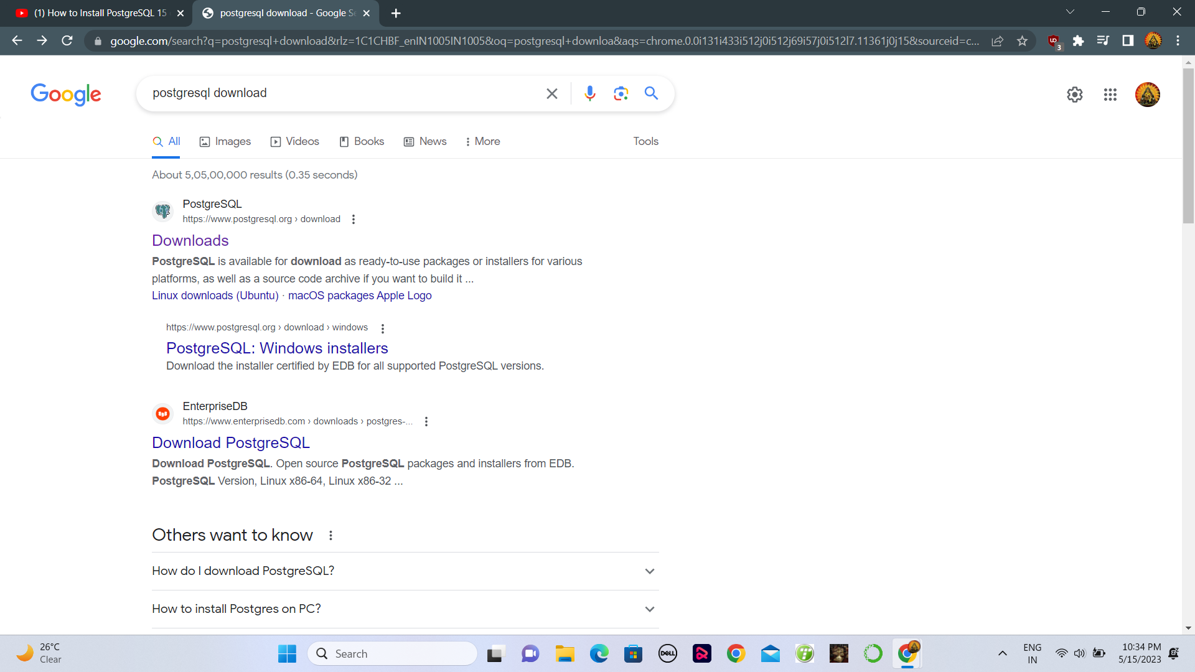

Slide 24
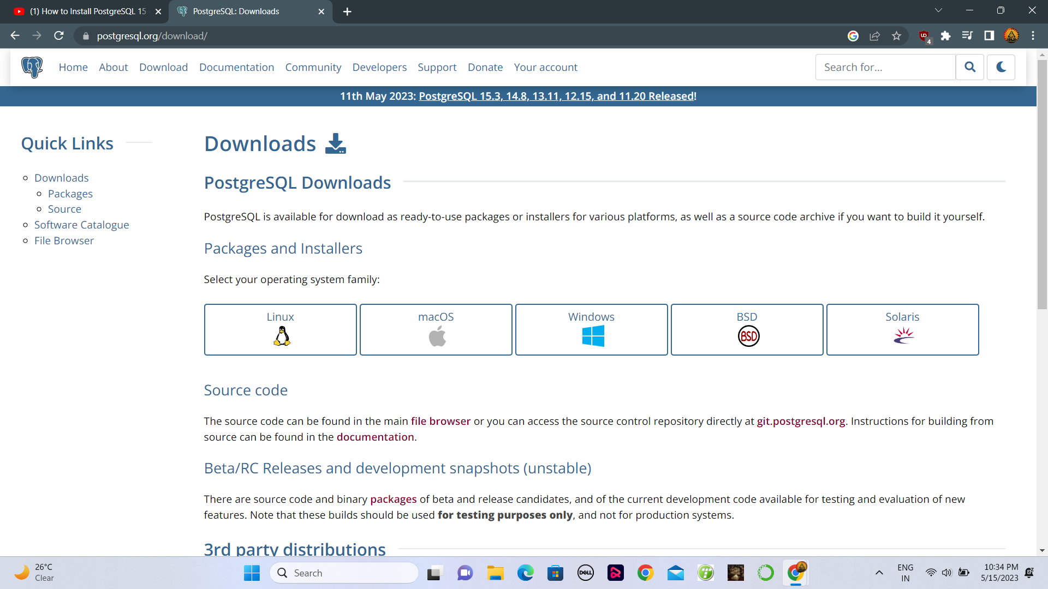

Slide 25
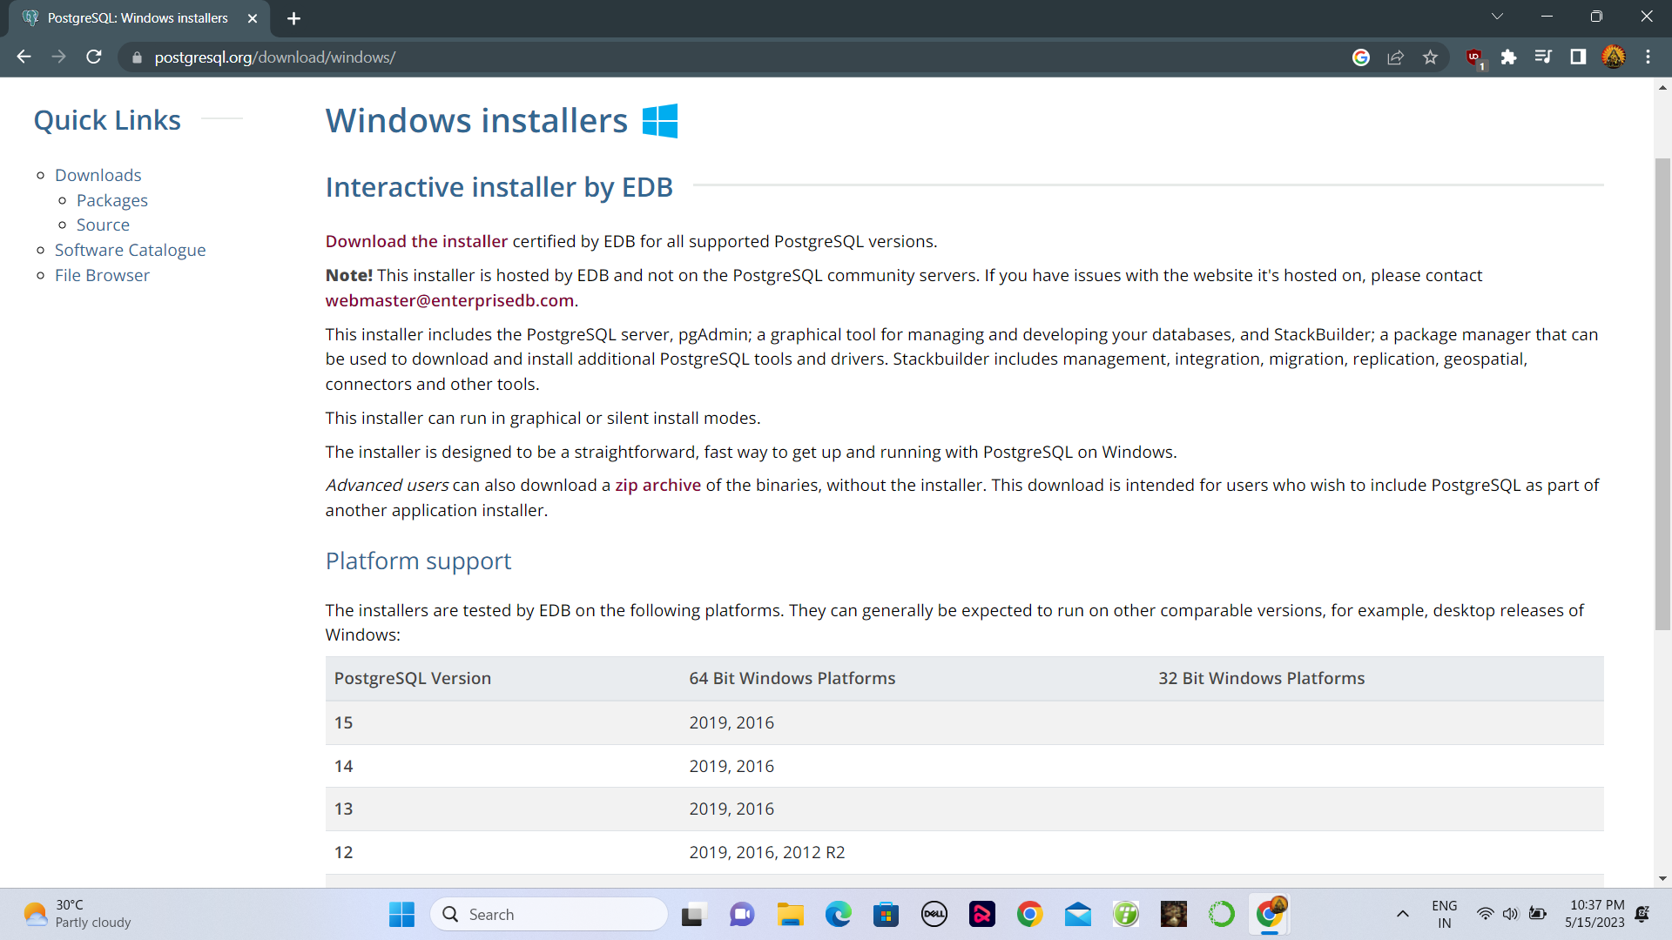

Slide 26
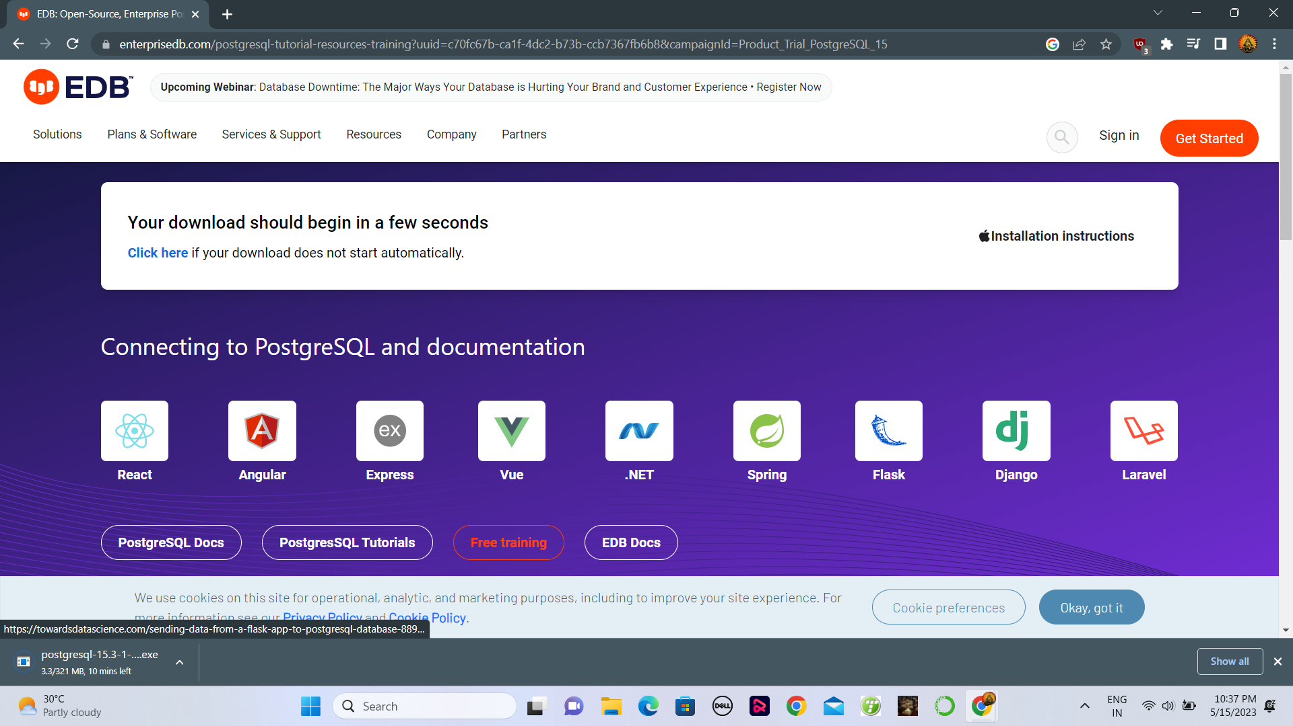

Slide 27
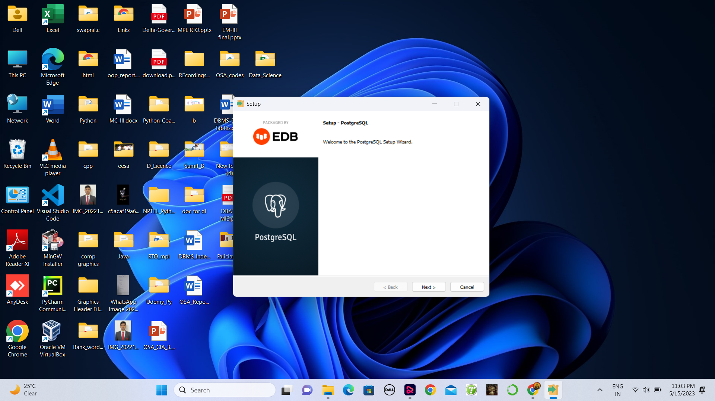

Slide 28
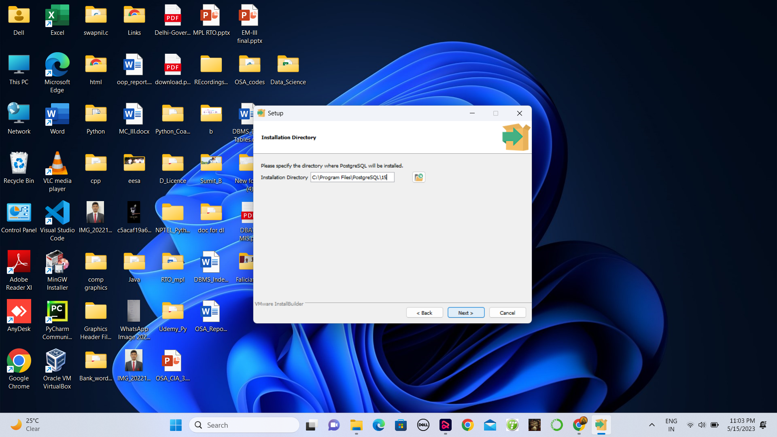

Slide 29
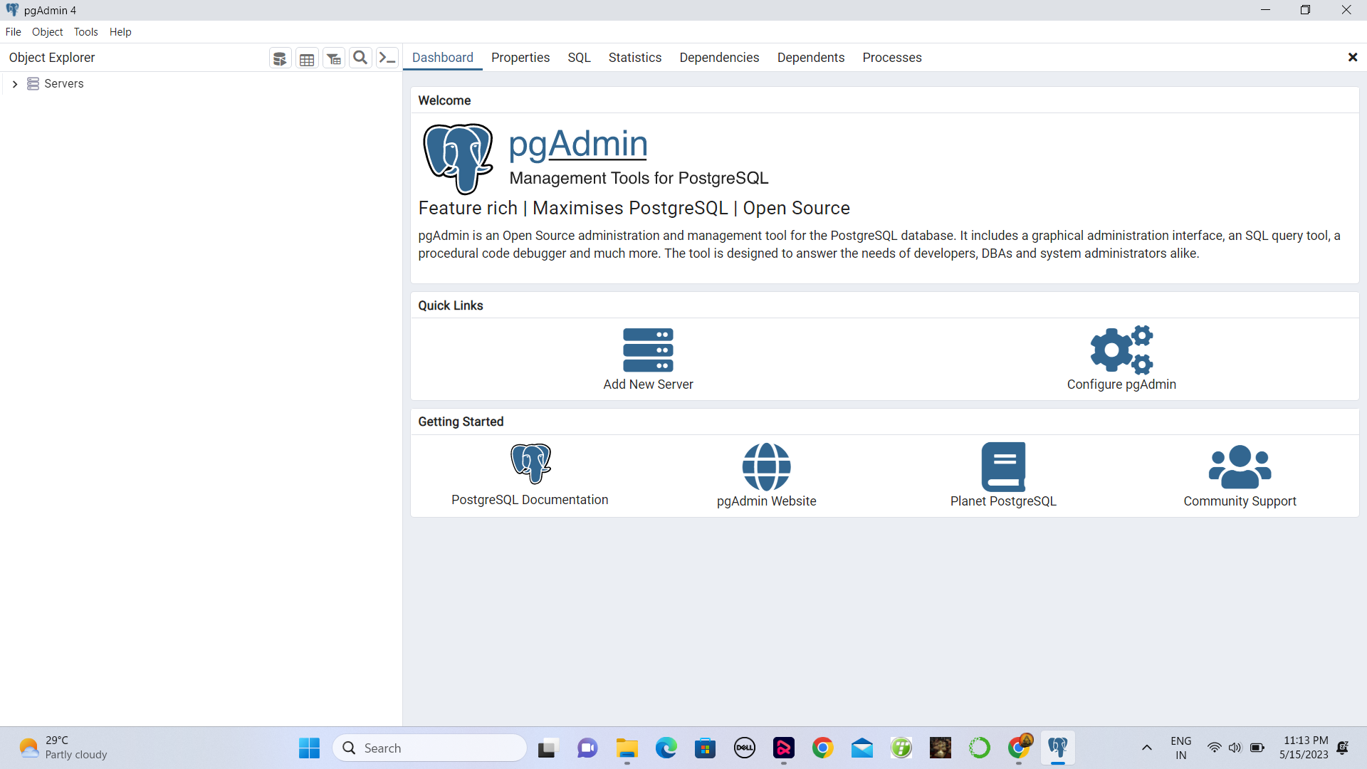

Slide 30
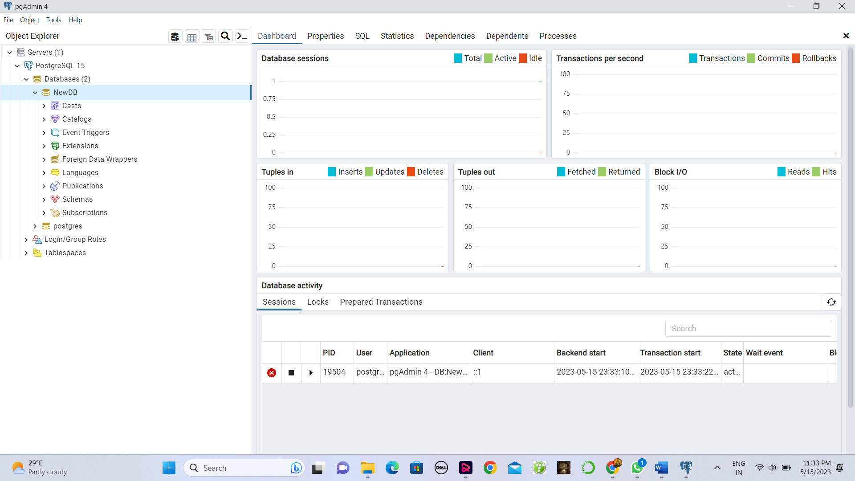

Slide 31

Thank you
Conclusion
At the conclusion of a PostgreSQL course, you should have gained a good understanding of the fundamentals of PostgreSQL, including data modeling, querying data, creating and managing tables, and implementing security features. You should have also learned about more advanced topics such as performance optimization, indexing, and database replication.
References :
https://infyspringboard.onwingspan.com/web/en/app/toc/lex_auth_01329460910229913614313_shared/overview

